Slide 1

Principles of Economics
Swagat Kishore Mishra
Lecturer, Dept. of Economics
Email: swagat@bits-goa.ac.in / sayswagat@gmail.com
VOIP: 207 PSRN: 485 CHAMBER: A-301/16
Tel. 0832-2580207 (O) 08879506995 (M)

Slide 2
ECONOMISTS for POE
Keynes, John Maynard
Smith, Adam
Friedman, Milton
Ricardo, David
Marx, Karl
Malthus, Thomas
Marshall, Alfred
Schumpeter, Joseph
Okun, Arthur
Stigler, George J.
Coase, Ronald H.
Galbraith, John K.
Kuznets, Simon
Lucas, Robert E.
Becker, Gary
Feldstein, Martin
Hayek, Friedrich Von

Slide 3
Adam Smith (Group-1)
1723-1790
‘ An Inquiry into the Nature and Causes of the Wealth of Nations ‘ .
Comprehensively analyzed wealth and prosperity.
Introduced the concept of “the invisible hand”.
Explained that the wealth of a nation was determined by its production of goods and services and not by its gold and silver.

Slide 4
David Ricardo (Group-2)
1772-1823
Wrote ‘ On the Principles of Political Economy and Taxation’.
Developed the law of comparative advantage and used it to explain why trade leads to mutual gains.

Slide 5
Alfred Marshall (Group-3)
1842-1924
Wrote ‘ The Principles of Economics’.
Introduced and developed the concepts of Supply and Demand, equilibrium, short run and long run, elasticity and consumer and producer surplus.

Slide 6
John Maynard Keynes (Group-4)
1883-1946
Wrote ‘ The General Theory of Employment, Interest and Money’.
Developed the framework for modern macroeconomics.
Developed an explanation for the widespread unemployment of the Great Depression, and elevated the importance of Fiscal Policy.

Slide 7
Friedrich von Hayek (Group-5)
1899-1992
Wrote ‘ The Road to Serfdom’ and ‘ The Use of Knowledge in Society’.
Explained role of knowledge in economics, enhanced our understanding of the market process, and highlighted the fatal defects of centrally planned economies.

Slide 8
Milton Friedman (Group-6)
1912-2006
Wrote ‘ A Monetary History of the United States’.
His work elevated the importance of monetary policy and convinced many that monetary instability was the major cause of both business fluctuations and inflation.

Slide 9
Robert Lucas (Group-7)
1937-Present Date
Wrote ‘Monetary Neutrality’ and won the Noble Prize in 1995 for this article on rational expectation.
Is recognized as the leading contributor to the fact that people’s expectations play in the macro economy a very dominant role and this altered prior economic analysis.

Slide 10
Arthur Okun(Group-8)
1928-1980
A Macroeconomist having the eclectic judgement to engulf Keynesian insights into real economic scenarios.
Named after him is a rule of thumb correlating Unemployment rate and real Gross National Product (GNP). Famously known as Okun’s law.

Slide 11
Karl Marx (Group-9)
1818-1883
A revolutionary thinker and philosopher and an economist to tackle the communist regime of 20th century.
His most widely read works include, ‘Communist Manifesto’, ‘Contribution to a critique of political economy’ and ‘Capital: Vol-1’.

Slide 12
Robert Lucas (Group-10)
1911-1991
His work titled as ‘The Economics of Information’ published in the Journal of Political Economy in 1961 highlighting ‘information’ as a valuable resource.
He adapted science and economics and once remarked that ‘Science is a Boy’s Best Friend.’
Economics of science was his research interest.

Slide 13
Thomas Malthus (Group-11)
1766-1834
Best known for his theories on population growth.
His major work include, ‘An essay on the principle of population’ and ‘Principles of political economy.’

Slide 14
Ronald Coase (Group-12)
1818-1883
Working on problem of social cost, his contribution is prominent in the emerging field of Environmental Economics and Natural Resource Economics.
Coase theorem on transaction costs and property rights won him Nobel prize.
His celebrated work is ‘Nature of the Firm.’

Slide 15
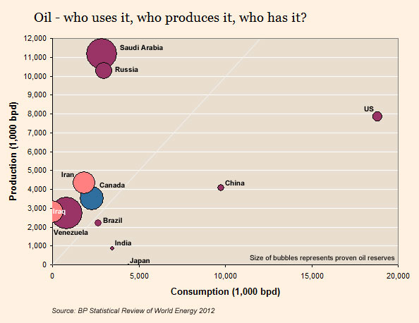
All the very best pupils!
Oil Production Versus Consumption
Saudi Arabia produces the most oil in the world, as you can see in this chart from the Financial Times. The United States is the country with the highest consumption in barrels, but also produces quite a lot. Japan sticks out in that it does consumes relatively much, but doesn't produce any oil. For Iraq it is the other way around.

